Slide 1

Data Science and Big Data Analytics
Day 1 :
Course overview and introduction to statistical learning
An introduction to using R
ISSU0053 Data Science Dr Phil Lewis

Slide 2
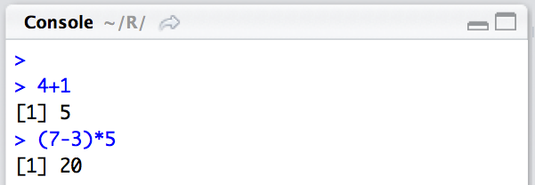
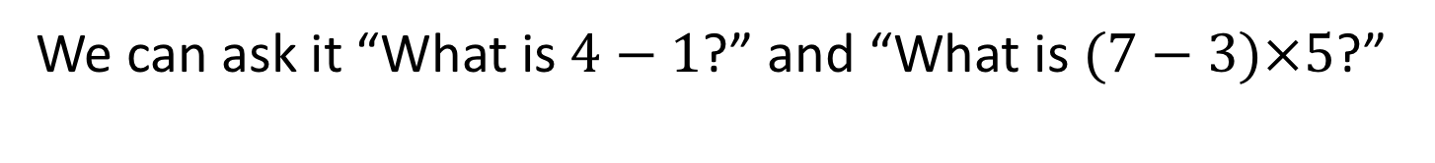
Introduction to R
… is like a calculator
We can ask it “What is $4−1$?” and “What is $(7−3)×5$?”
ISSU0053 Data Science Dr Phil Lewis

Slide 3
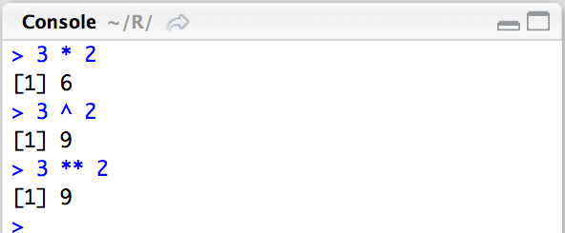
Introduction to R
… is like a scientific calculator
We can calculate powers using ^ or **
ISSU0053 Data Science Dr Phil Lewis

Slide 4
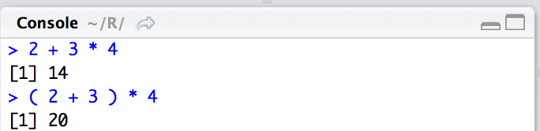
Introduction to R
… is like a scientific calculator
We can use round brackets to structure expressions
ISSU0053 Data Science Dr Phil Lewis

Slide 5
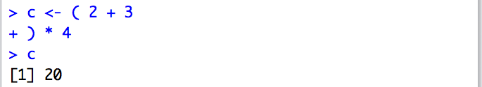
Introduction to R
… is like a scientific calculator
If brackets aren’t closed your command will continue onto the next line
ISSU0053 Data Science Dr Phil Lewis

Slide 6
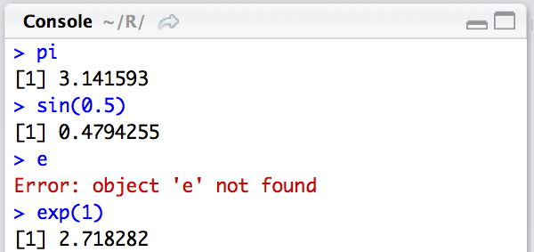
Introduction to R
… is like a scientific calculator
We can do trigonometry and access stored constants.
Here sin is a R function we can call. We put the argument needed by the function in round brackets ().
ISSU0053 Data Science Dr Phil Lewis

Slide 7
Introduction to R
… is like a scientific calculator
We can do trigonometry and access stored constants.
ISSU0053 Data Science Dr Phil Lewis

Slide 8
Introduction to R
… is like a scientific calculator
We can do trigonometry and access stored constants.
ISSU0053 Data Science Dr Phil Lewis

Slide 9
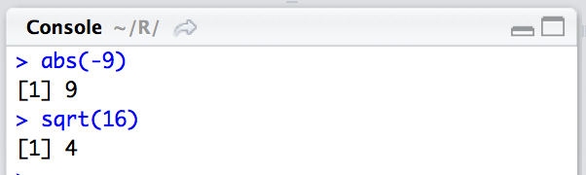
Introduction to R
… is like a scientific calculator
and other useful functions
ISSU0053 Data Science Dr Phil Lewis

Slide 10
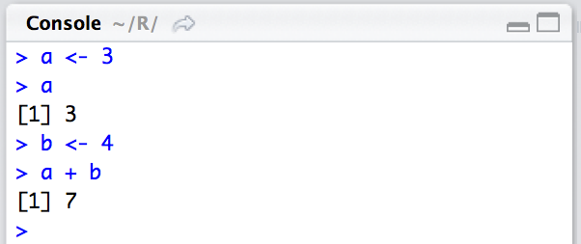
Introduction to R
… is like a programming language
We can assign values to variables using <-
ISSU0053 Data Science Dr Phil Lewis

Slide 11
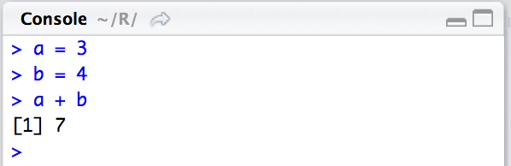
Introduction to R
… is like a programming language
We can assign values to variables using <-
( even though we could use = )
ISSU0053 Data Science Dr Phil Lewis

Slide 12
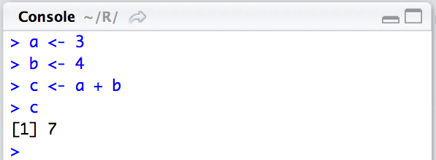
Introduction to R
… is like a programming language
We can use variables to create new variables
ISSU0053 Data Science Dr Phil Lewis

Slide 13
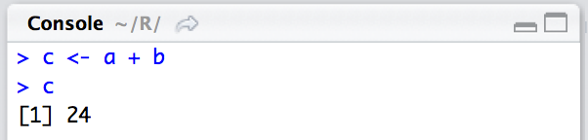
Introduction to R
… is like a programming language
We have to ask R to recalculate c if we want to update it.
ISSU0053 Data Science Dr Phil Lewis

Slide 14
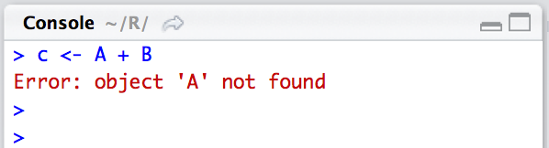
Introduction to R
… can be a bit sensitive!
( the CASE oF your COde MaTTERs! }
R is case-sensitive. It doesn’t treat a and A as the same variable. This applies to all code you enter and to other characters too!
Also be careful with symbols that look alike e.g. ( [ { !!!
ISSU0053 Data Science Dr Phil Lewis

Slide 15
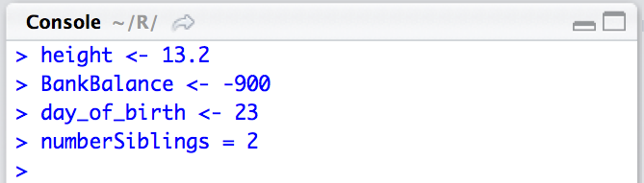
Introduction to R
… let’s you express yourself
Choosing names for variables
ISSU0053 Data Science Dr Phil Lewis

Slide 16
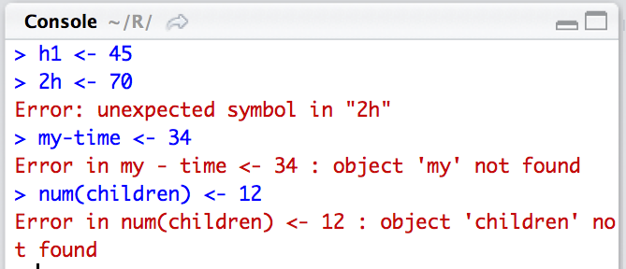
Introduction to R
… let’s you express yourself (up to a point)
Choosing names for variables
ISSU0053 Data Science Dr Phil Lewis

Slide 17
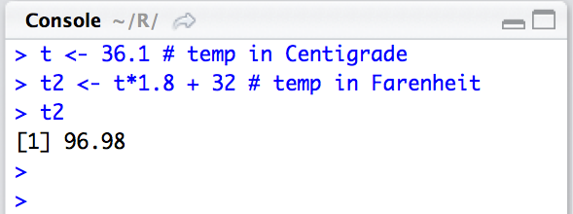
Introduction to R
… let’s you explain
Anything written after a # hash symbol is treated as a comment and ignored by R
ISSU0053 Data Science Dr Phil Lewis

Slide 18
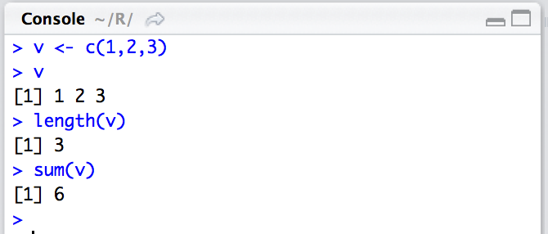
Introduction to R
… knows about vectors (a.k.a arrays)
We will often use the c() function to combine multiple elements into a vector.
ISSU0053 Data Science Dr Phil Lewis

Slide 19
Introduction to R
… knows about vectors
ISSU0053 Data Science Dr Phil Lewis

Slide 20
Introduction to R
… knows about vectors
ISSU0053 Data Science Dr Phil Lewis

Slide 21
Introduction to R
… knows about vectors
ISSU0053 Data Science Dr Phil Lewis

Slide 22
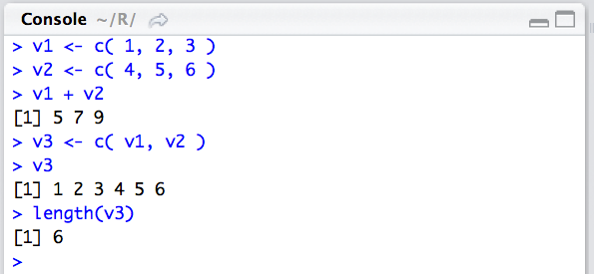
Introduction to R
… can can combine vectors together
ISSU0053 Data Science Dr Phil Lewis

Slide 23
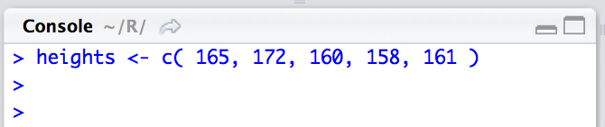
Introduction to R
… can use vectors to store data
ISSU0053 Data Science Dr Phil Lewis

Slide 24
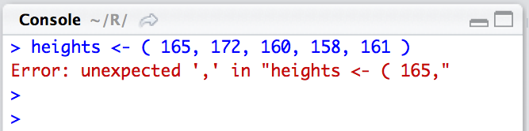
Introduction to R
… doesn’t like it if you forget things!
this happens if you forget to include the c (stands for combine)
ISSU0053 Data Science Dr Phil Lewis

Slide 25
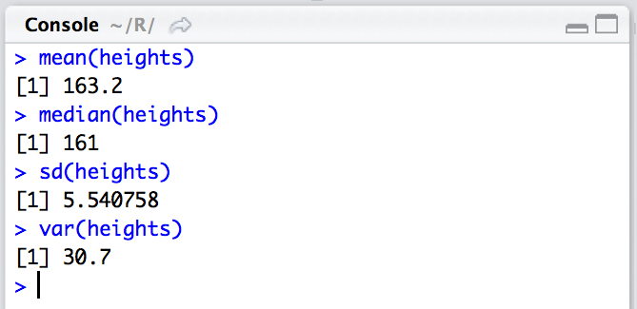
Introduction to R
… can even do statistics on vectors
ISSU0053 Data Science Dr Phil Lewis

Slide 26
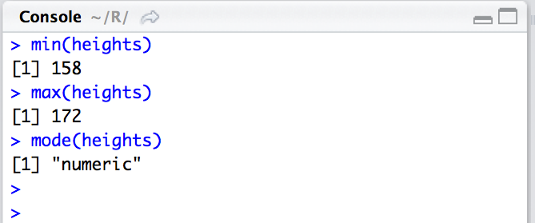
Introduction to R
… can even do statistics on vectors
ISSU0053 Data Science Dr Phil Lewis

Slide 27
Introduction to R
… can even do statistics on vectors
????
ISSU0053 Data Science Dr Phil Lewis

Slide 28
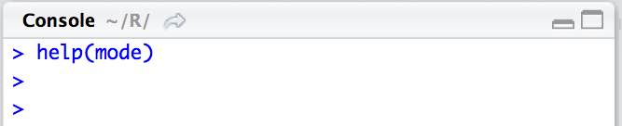
Introduction to R
… will help us (if we ask!)
ISSU0053 Data Science Dr Phil Lewis

Slide 29
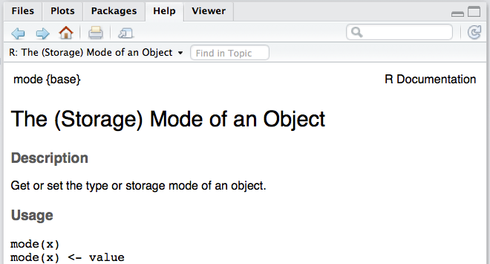

Introduction to R
… will help us (if we ask!)
ISSU0053 Data Science Dr Phil Lewis

Slide 30
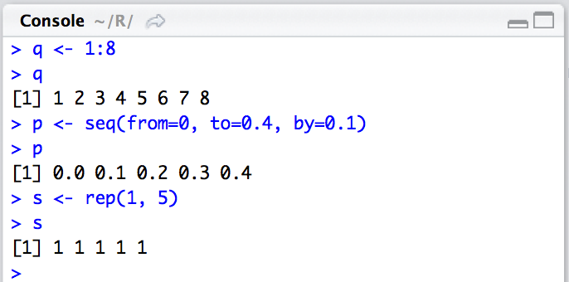
Introduction to R
… has shortcuts to generating sequences
Use help( ) to find out more about the functions
seq and rep
ISSU0053 Data Science Dr Phil Lewis

Slide 31
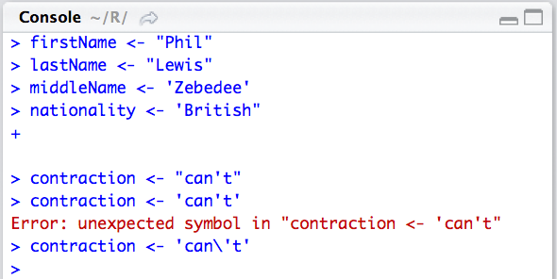
Introduction to R
… let’s us store text
We can enter character data using either single or double quotes.
ISSU0053 Data Science Dr Phil Lewis

Slide 32
Introduction to R
… let’s us store text
Don’t mix singles and doubles !!!
press the escape key, if you can’t end a command…
ISSU0053 Data Science Dr Phil Lewis

Slide 33
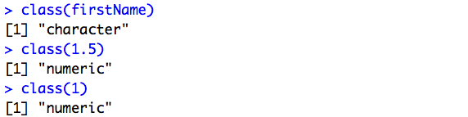
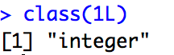
Introduction to R
… let’s us store text
The class() function lets us ask what type of data each variable contains.
If a number is stored as an integer (whole number value) it will be followed by the letter L.
ISSU0053 Data Science Dr Phil Lewis

Slide 34
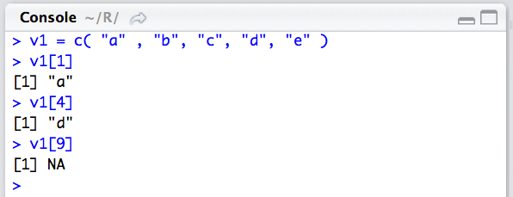
Introduction to R
… let’s us store text in a vector
ISSU0053 Data Science Dr Phil Lewis

Slide 35
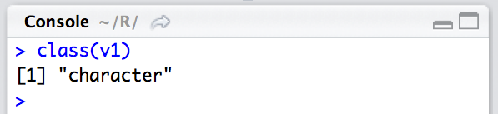
Introduction to R
… let’s us store text in a vector
We can use the class function to find the type of data in the vector.
ISSU0053 Data Science Dr Phil Lewis

Slide 36
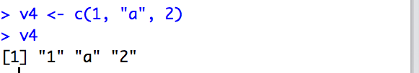
Introduction to R
… let’s us store text in a vector
Vectors can only contain one type of data.
Here R has converted all elements of v4 into characters.
ISSU0053 Data Science Dr Phil Lewis

Slide 37
Introduction to R
… can access elements of vectors using indexes
The first item in vector has index 1.
(This is not the case in other programming languages)
ISSU0053 Data Science Dr Phil Lewis

Slide 38
Introduction to R
… can access elements of vectors using indexes
Note that R does not raise an error when we try to access data that is beyond the end of the vector!
ISSU0053 Data Science Dr Phil Lewis

Slide 39
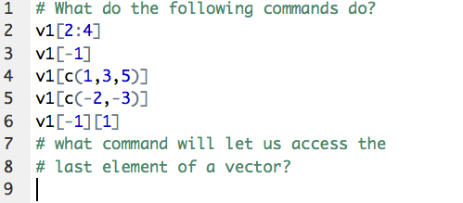
Introduction to R
… can access elements of vectors using indexes
ISSU0053 Data Science Dr Phil Lewis

Slide 40
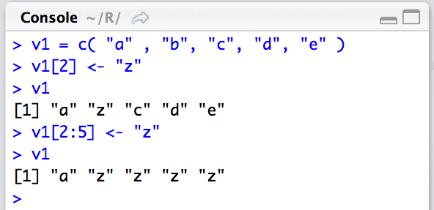
Introduction to R
… can access elements of vectors using indexes
We can also update the contents of the vector
ISSU0053 Data Science Dr Phil Lewis

Slide 41
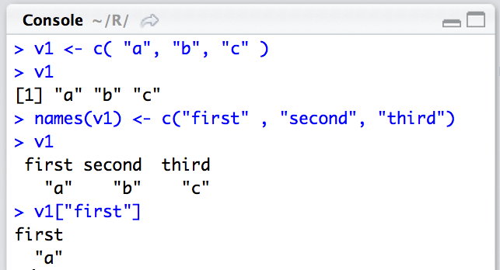
Introduction to R
… lets us label our vector elements with names
ISSU0053 Data Science Dr Phil Lewis

Slide 42
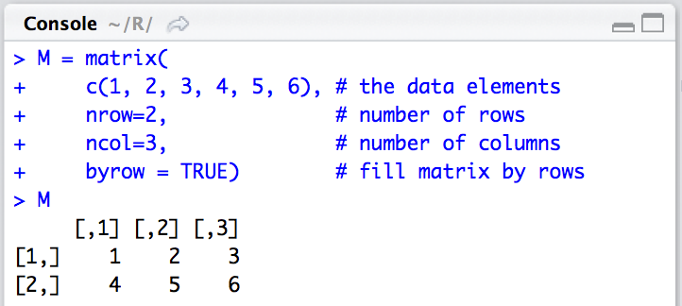
Introduction to R
… lets us work with matrices
The input to the matrix function is the data in the form of a 1-D vector, and information on the dimensions, and how the data is arranged.
ISSU0053 Data Science Dr Phil Lewis

Slide 43
Introduction to R
… lets us work with matrices
ISSU0053 Data Science Dr Phil Lewis

Slide 44
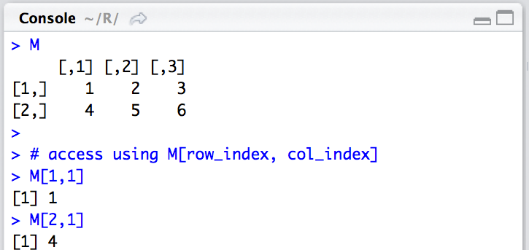
Introduction to R
… lets us work with matrices
ISSU0053 Data Science Dr Phil Lewis

Slide 45
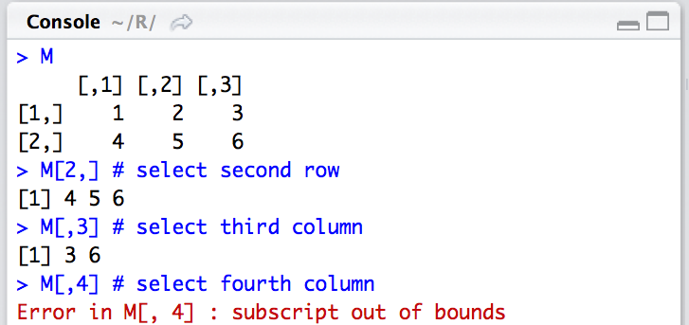
Introduction to R
… lets us work with matrices
ISSU0053 Data Science Dr Phil Lewis

Slide 46
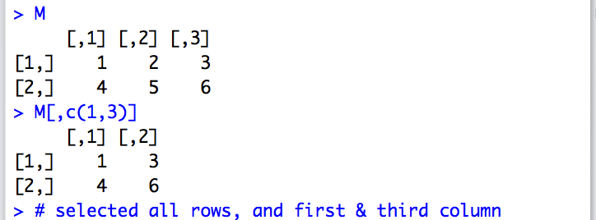
Introduction to R
… lets us work with matrices
ISSU0053 Data Science Dr Phil Lewis

Slide 47
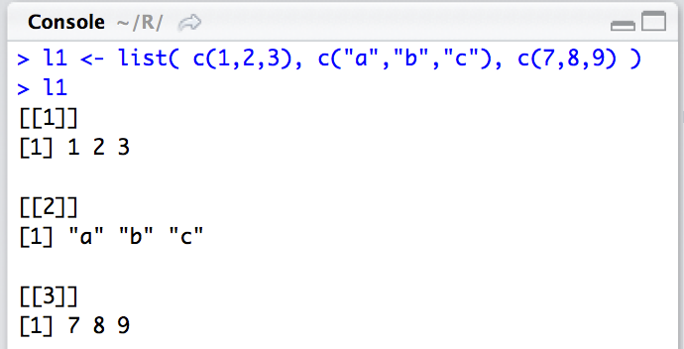
Introduction to R
… let’s us store lists (can contain vectors of different data types).
double square brackets mean list element index
ISSU0053 Data Science Dr Phil Lewis

Slide 48
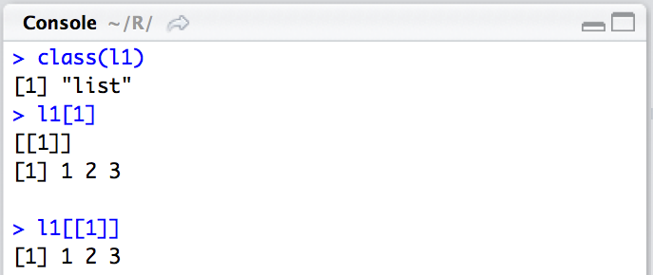
Introduction to R
… let’s us store lists (can contain vectors of different data types).
output is a list
output is a vector
ISSU0053 Data Science Dr Phil Lewis

Slide 49
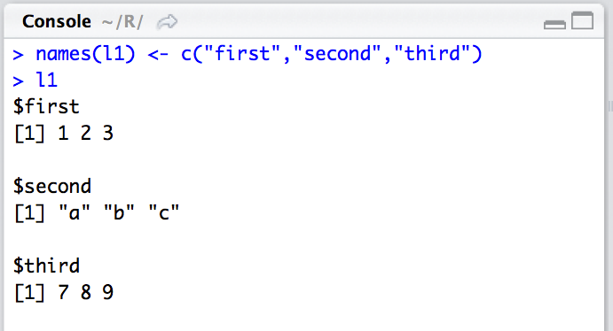
Introduction to R
… let’s us store lists (can contain vectors of different data types).
If we label the list elements we see a dollar $ instead of [[index]]
ISSU0053 Data Science Dr Phil Lewis

Slide 50
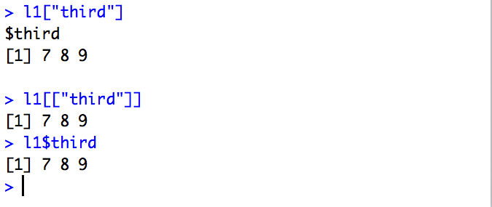
Introduction to R
… let’s us use shortcuts!
output is a list
output is a vector
SHORTCUT!
output is a vector
ISSU0053 Data Science Dr Phil Lewis

Slide 51
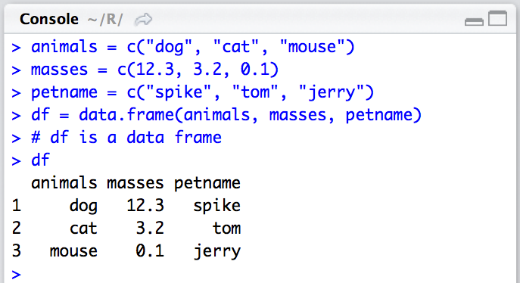
Introduction to R
… is based around Data Frames
ISSU0053 Data Science Dr Phil Lewis

Slide 52

Introduction to R
… is based around Data Frames
ISSU0053 Data Science Dr Phil Lewis

Slide 53
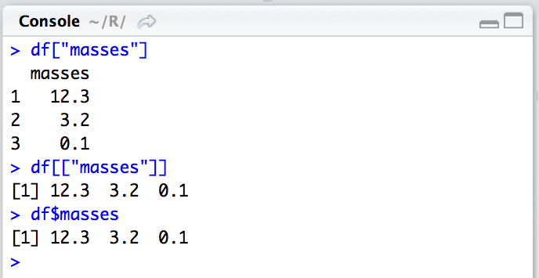
Introduction to R
… is based around Data Frames
(structured as a lists of vectors)
output is a data frame
output is a vector
output is a vector
ISSU0053 Data Science Dr Phil Lewis

Slide 54
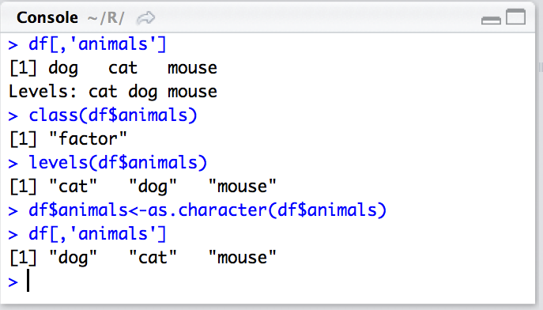
Introduction to R
… lets you use a special data type for categorical data.
ISSU0053 Data Science Dr Phil Lewis

Slide 55
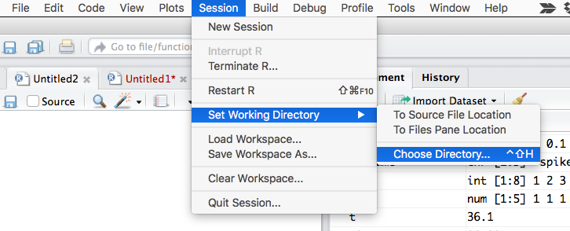
Introduction to R
… likes to know where files can be found.
ISSU0053 Data Science Dr Phil Lewis

Slide 56
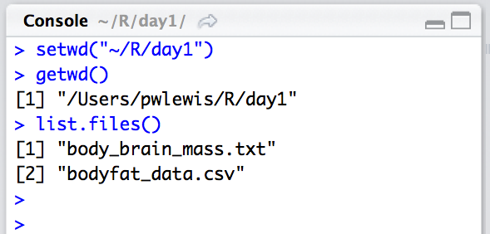
Introduction to R
… likes to know where files can be found.
ISSU0053 Data Science Dr Phil Lewis

Slide 57
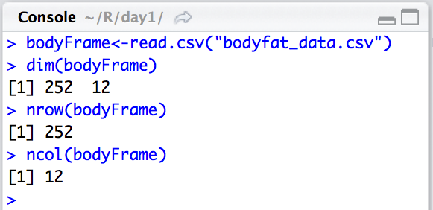
Introduction to R
… can read in common data formats into data frames
ISSU0053 Data Science Dr Phil Lewis

Slide 58
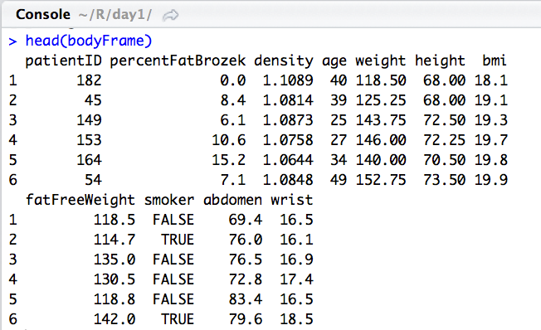
Introduction to R
… can give you a look at the first rows of the data
ISSU0053 Data Science Dr Phil Lewis

Slide 59
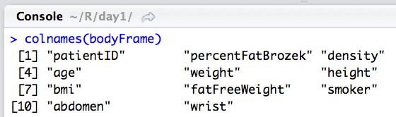
Introduction to R
… can show you the data frames columns
ISSU0053 Data Science Dr Phil Lewis

Slide 60
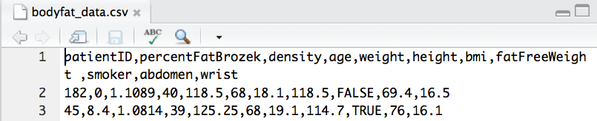

Introduction to R
… converts text in csv files intelligently
Row 1 used for column names
R selects an appropriate types for loaded data.
ISSU0053 Data Science Dr Phil Lewis

Slide 61

Introduction to R
Cleaning up the data:
setting patientID as the row name
ISSU0053 Data Science Dr Phil Lewis

Slide 62

Introduction to R
Cleaning up the data:
Removing the patientID column
bodyFrame[,-1] creates a copy of bodyFrame with all rows,
and all columns except column 1
ISSU0053 Data Science Dr Phil Lewis

Slide 63
Introduction to R
Cleaning up the data:
Removing the patientID column
We use this to overwrite our original data frame with the copy that omits column 1
ISSU0053 Data Science Dr Phil Lewis

Slide 64


Introduction to R
… can be logical
Relational operators: > < == != >= <=
ISSU0053 Data Science Dr Phil Lewis

Slide 65


Introduction to R
… logic can be combined
operators: AND OR NOT
& | !
ISSU0053 Data Science Dr Phil Lewis

Slide 66

Introduction to R
… logic can be selective
The mask is TRUE for all elements except “a”.
We can use the mask to select elements to change.
ISSU0053 Data Science Dr Phil Lewis

Slide 67

Introduction to R
… logic can seem complicated?
ISSU0053 Data Science Dr Phil Lewis

Slide 68
Introduction to R
… logic can seem complicated?
ISSU0053 Data Science Dr Phil Lewis

Slide 69

Introduction to R
… lets you see summary statistics of the data
ISSU0053 Data Science Dr Phil Lewis

Slide 70

Introduction to R
… lets you draw plots of the data
ISSU0053 Data Science Dr Phil Lewis

Slide 71

Introduction to R
… lets you draw plots of the data
ISSU0053 Data Science Dr Phil Lewis

Slide 72


Introduction to R
… lets you draw plots of the data
ISSU0053 Data Science Dr Phil Lewis

Slide 73

Introduction to R
… lets you draw plots of the data
ISSU0053 Data Science Dr Phil Lewis

Slide 74

Introduction to R
… lets you draw plots of the data
ISSU0053 Data Science Dr Phil Lewis

